Slide 1


HubListener
Pedro Oliveira, Zed Ahmad, Piranaven Selva, Prakhar Jalan
Supervised by dr. smith
Notes:
- Introductions
- Mention that we are being supervised by Dr. Smith

Slide 2


Our tool : HubListener
GitHub project analysis tool
  Provides users with relevant metrics, trends, and information
  Puts the given repository against a set of the most popular projects on GitHub
Intended for project review and evaluation
  Up to the user to make any improvements or corrections based on their observations
“What specific metrics lead to success, and how do we measure this success?” - HubListener 2018
Notes:
Concise explanation on what is HubListener and how it essentially works
Can mention that this is not a serious user problem, as most GitHub projects already use a variety of other tools to evaluate their growth and track their overall progress. However, we are still providing a tool that can make it easier for a user to notice any potential patterns that could leave an impact however small (i.e. organizational changes)
Can refer to SRS for even more SPECIFIC content regarding our motivations and considerations. Here are the assumptions from our SRS (maybe make new slide for assumptions?):
There are a few factors that influence the product. The first business rule to be addressed is the amount of GitHub repositories we can clone. As we are grabbing several projects for reference directly from GitHub, we are limited to clone at a ‘reasonable’ pace. Cloning the estimated 100 repositories in parallel is not something GitHub takes lightly, as it can be detected as abusive behavior by their automated measures. Another key factor that affects this product is the specific information we will be extracting from the initial list of projects. This information can vary drastically, and so we will be selective of the types of projects gathered. To elaborate, we may only take projects created in one specific programming language to even the playing field regarding any comparisons to be made.
The initial database of projects we will use for comparison, will be that of the most popular and ‘successful’ GitHub projects
The most popular projects on GitHub contain quality code and documentation
NPM packages used as dependencies are accurate, complete and correct
Each user will have their own GitHub API Authentication token.

Slide 3

OUR Consumer audience
General consumer audience
  Any member of the open-source community (with experience using open-source software)
Example User Groups:
  Developers and Creators
  Students
  Researchers
  Companies/Organizations
  Project Managers
Notes:
Here we can talk about who we are trying to deliver this software to (potential users), and maybe why it would make sense in their hands
In the pitch examples, there’s a lot mentioned regarding the ‘customer’, but obviously in our case, fulfilling customer needs or talking about strengths/advantages of our software relative to the traditional methods of analysis may actually not work in our favor (we are inconvenient as a tool for majority of users, but we have a spot in research)

Slide 4

OUR DEMO

Slide 5

Our METRICS
Static Metrics used for Static Analysis
Number of Files
Number of Lines
Number of Logical Lines
Number of Comments
Halstead Effort
Halstead Bugs
Halstead Length
Halstead Difficulty
Halstead Time
Halstead Vocabulary
Halstead Volume
GitHub metrics:
Number of Open Issues
Number of Closed Issues
Total Number of Issues
Cyclomatic Complexity
Collected on a PER COMMIT basis; giving you a COMPLETE history
Notes:
We chose the most popular metrics for similar for static analysis; looked at various packages and tools that do these sort of things.
The idea is to bring what GitHub provides, as well as the static analysis, bring them together, and allow customizability
Currently we do not have …. in place, but there is tons of room for expansion and doing so..
DONE on a per commit basis, so you are given a COMPLETE history

Slide 6
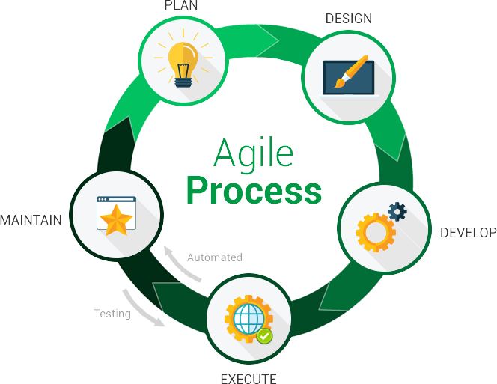


Our process
Agile approach
  GitHub issues & ZenHub for project management
  https://github.com/pjmc-oliveira/HubListener
Ongoing focus on documentation
  Development Plan, Requirements Specification, Verification & Validation, Module Diagram, detailed Onboarding plan and more…
  GitHub Wiki: Contributors Guide, Quick Start, and References
Ongoing focus on performance/optimization
  Design decision voting
  Defined the purpose and impact of these decisions
Notes:
Discuss our approach to project management, talk about how Dr. Smith was instrumental to our success/discipline in this area, design decisions, peer reviewing, task divisions, schedule (3-4 meetings a week), with bi-weekly meetings with Dr. Smith.
Travis CI

Slide 7


